Slide 1
B2B: 全方位數碼行銷方案
B2B: WebSolutions
Celine Leung
業務拓展及傳訊部經理
Sales and Communications Manager
本簡報中提到的收入等級純屬舉例說明，無意代表美安香港超連鎖™店主的一般收入，也無意表示任何超連鎖™店主皆可賺取同等收入。美安香港超連鎖™店主的成功與否，取決於其在發展事業時的努力、才能與投入程度。The income levels mentioned in the following presentation are for illustration purposes only. They are not intended to represent the income of a typical Market Hong Kong UnFranchise ™Owner, nor are they intended to represent that any given Independent UnFranchise ™ Owner will earn income in that amount. The success of any Market Hong Kong Independent UnFranchise ™ Owner will depend upon the amount of hard work, talent, and dedication which he or she devotes to building his or her Market Hong Kong Business.

Slide 2
[
]
BUSINESS TO BUSINESS
WEBSOLUTIONS I UNFRANCHISE SOLUTIONS

Slide 3
全方位數碼行銷方案
Notes:
TRAINER’S NOTES:
MOST IMPORTANT: “LISTEN FOR” So you can offer a solution to the problem
You can use the B2B Catalog (pictured on the right) to educate a client on how we compare and what we offer with our core solution
Product Specialists can answer further questions on this during an appointment
There are FAQs on mawc411.com and mawebcenters.com

Slide 4
網站管理
Notes:
TRAINER’S NOTES:
MOST IMPORTANT: “LISTEN FOR” So you can offer a solution to the problem
You can use the B2B Catalog (pictured on the right) to educate a client on how we compare and what we offer with our core solution
Product Specialists can answer further questions on this during an appointment
There are FAQs on mawc411.com and mawebcenters.com

Slide 5
設計選項
Notes:
TRAINER’S NOTES:
MOST IMPORTANT: “LISTEN FOR” So you can offer a solution to the problem
You can use the B2B Catalog (pictured on the right) to educate a client on how we compare and what we offer with our core solution
Product Specialists can answer further questions on this during an appointment
There are FAQs on mawc411.com and mawebcenters.com

Slide 6
搜尋引擎優化
GOOGLE 關鍵字
FACEBOOK廣告
社交媒體
Notes:
TRAINER’S NOTES:
MOST IMPORTANT: “LISTEN FOR” So you can offer a solution to the problem
You can use the B2B Catalog (pictured on the right) to educate a client on how we compare and what we offer with our core solution
Product Specialists can answer further questions on this during an appointment
There are FAQs on mawc411.com and mawebcenters.com

Slide 7
三款評量表
即將可供下載 1. 網站設計／管理
2. 社交媒體
3. 商務開支
Notes:
TRAINER’S NOTES:
Flyers and catalogs be downloaded at www.mawc411.com
You can print these or email them to prospective WebCenter Owners to peak their interest about our program and products

Slide 8
B2B產品目錄
即將可供下載
Notes:
TRAINER’S NOTES:
Flyers and catalogs be downloaded at www.mawc411.com
You can print these or email them to prospective WebCenter Owners to peak their interest about our program and products

Slide 9
商業服務：遠超過只是網站銷售
您的顧客購買了一個網站
銷售項目 | 零售利潤 | BV
網站銷售 | HK$7,700 | 200 BV 30/ 每月
設計套裝 |  | 50 BV
社群媒體管理 | HK$117/每月 | 20 BV/每月
優質臉書廣告 | HK$79/每月 | 15 BV/每月
基本 GOOGLE 廣告 | HK$185/每月 | 24 BV/每月
總銷售利潤 | HK$8,081 | 339 BV
總循環點數 | HK$381/ 每月 | 89 BV/ 每月
之後，他們又想要行銷網站
Notes:
講師筆記:
看一下數位行銷產品可產生的利潤與BV
請記得，可以在 mawc411.com/support.html 下載零售價格、BV資料

Slide 10
B2B: 全方位數碼行銷方案
B2B: WebSolutions
Maggie Su
主管經理級
Master Coordinator
四個佣金週期共賺取HK$16,100
HK$16,100 in 4 Commission weeks
本簡報中提到的收入等級純屬舉例說明，無意代表美安香港超連鎖™店主的一般收入，也無意表示任何超連鎖™店主皆可賺取同等收入。美安香港超連鎖™店主的成功與否，取決於其在發展事業時的努力、才能與投入程度。The income levels mentioned in the following presentation are for illustration purposes only. They are not intended to represent the income of a typical Market Hong Kong UnFranchise ™Owner, nor are they intended to represent that any given Independent UnFranchise ™ Owner will earn income in that amount. The success of any Market Hong Kong Independent UnFranchise ™ Owner will depend upon the amount of hard work, talent, and dedication which he or she devotes to building his or her Market Hong Kong Business.

Slide 11
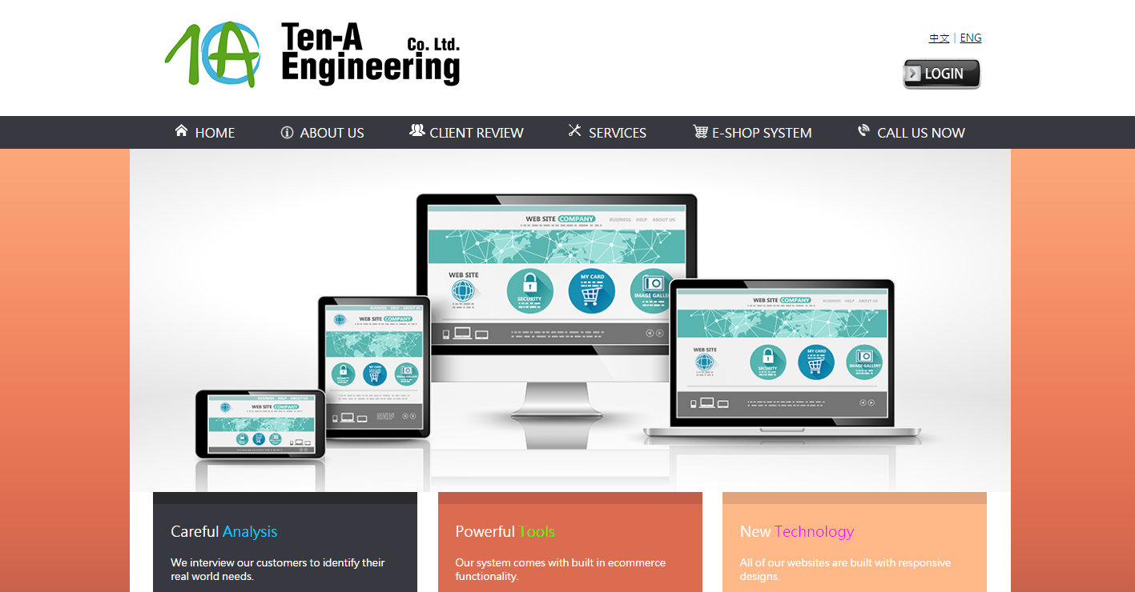

Slide 15
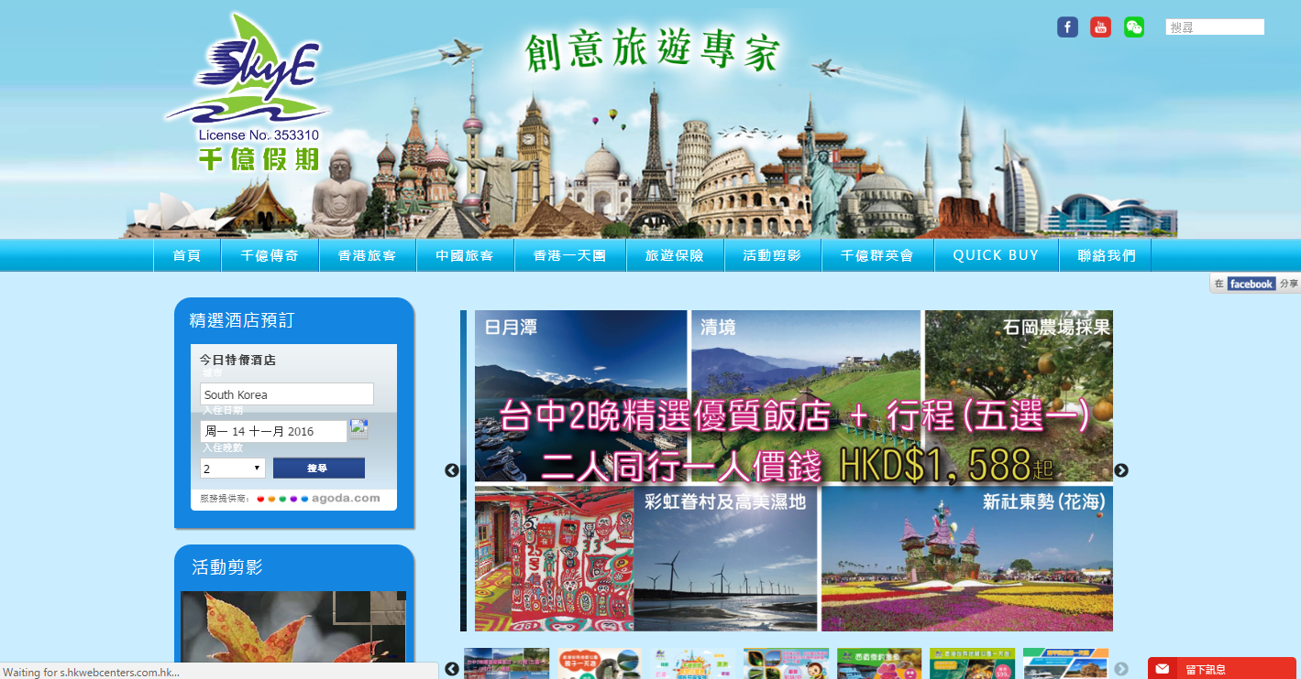

Slide 16
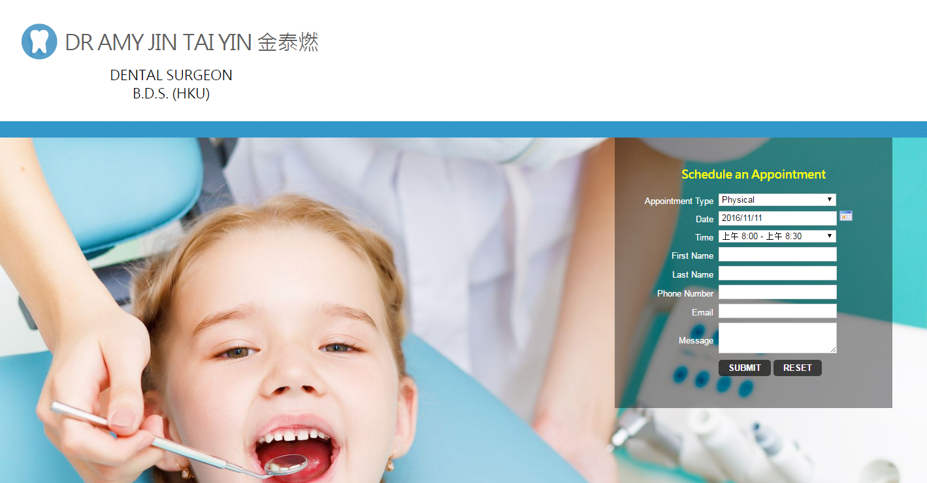

Slide 17
立即訂購2017美安香港年會門票！
日期：2017年5月5-7日
地點：九龍灣國際展貿中心滙星
票價：HK$1,089
免費
網路中心
只限今個周末！
購買三張票，即可免費獨贈Isotonix OPC-3一瓶、Lumiere de Vie 火山泥去角質面膜，及美安香港網路中心一個，總值高達HK$3,785！
另外，還有星級領袖特別分享門票兩張，數量有限，送完即止！

